Slide 1
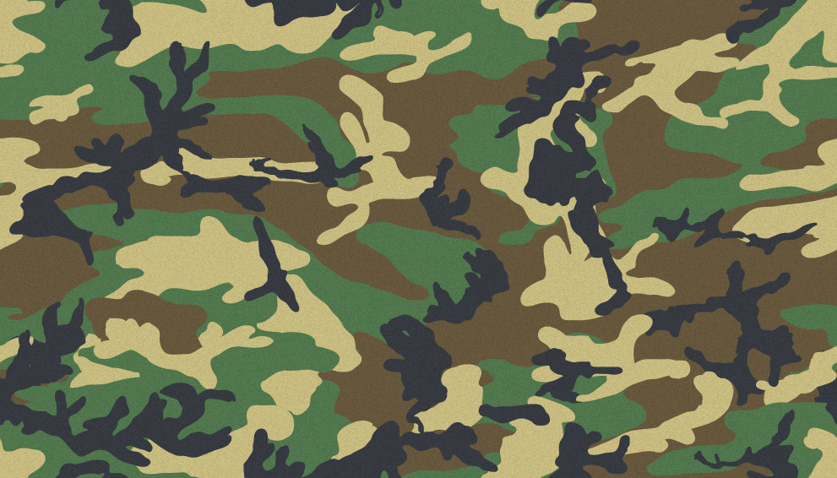
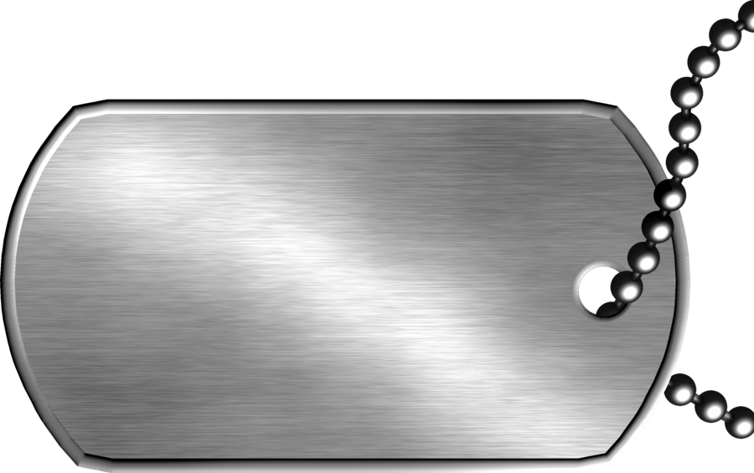
Most Epic
War Game
Anh

Slide 2
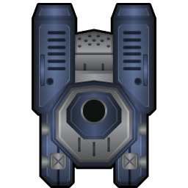
Project
Turn based game
Human vs human
Each turn consists of two phases
-Mouvement
-Attack
Games ends when a player loses all troopers

Slide 3
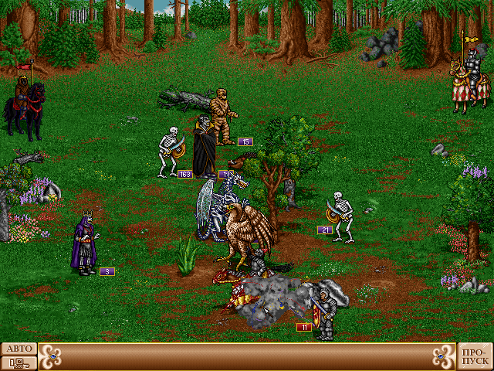
Why this project?
I grew up with this type of game
Play around with CSS

Slide 4
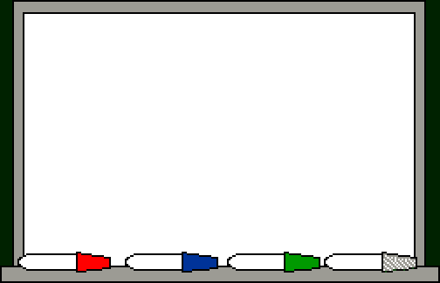

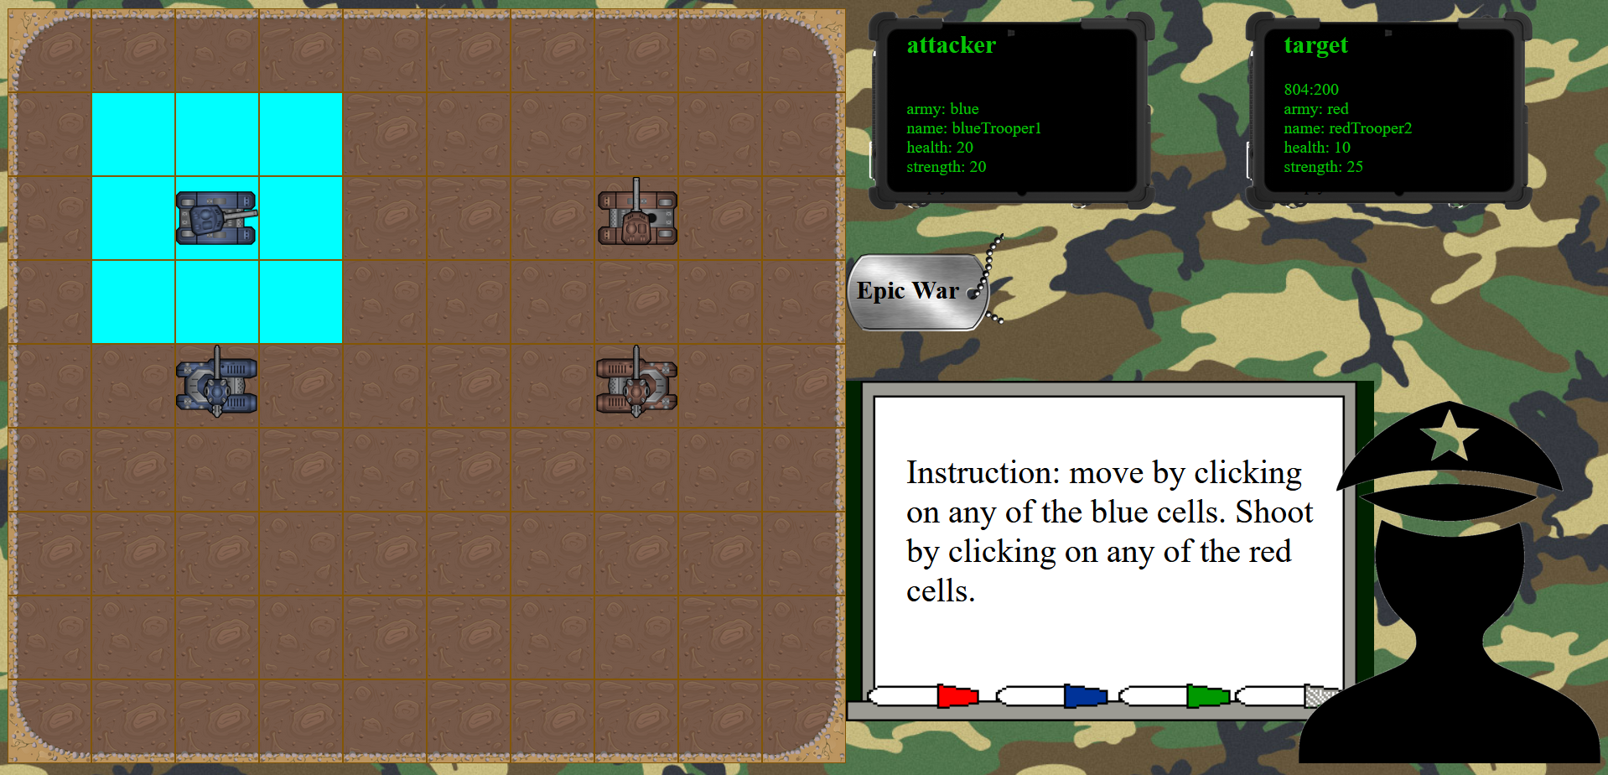
Demo Time

Slide 5
Technical Challenges
Multiple layer of animations via CSS
Applying the right concept at the right time
Getting the state machine right

Slide 6
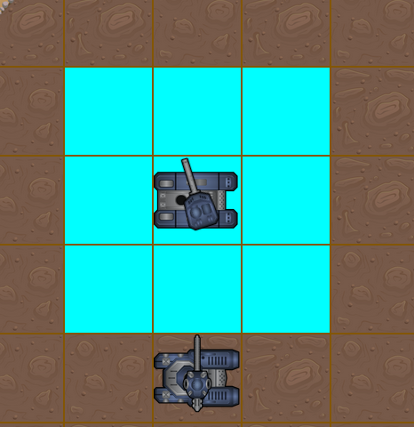
Big Mistake
Bottom up approach, starting with lot of buttons and corresponding event listener
Each cell is a button with its own eventListener and callback function
Endless chaining of function

Slide 7
Next Steps
More unit types
Obstacles blocking movement or firing
Animation of movement with tracks
Refactoring, better separation of concerns

Slide 8
Thank you!

